Slide 1

Analysis of NYC Neighborhood Financial & Social Data
Neighborhood Financial Health
Sahar Ahmadi
12/19/2025

Slide 2
Introduction
Dataset: Neighborhood Financial Health Digital Mapping and Data Tool
52 columns, 386 rows
poverty rates, various financial health indicators, demographics, median incomes, and social indicators.

Slide 3
Purpose
Inform policy decisions, resource allocation, community support programs, policymakers, and city planners to allocate resources effectively and design programs that target underserved areas.

Slide 4
Research Questions
▪ How do IndexScores vary across NYC boroughs and neighborhoods?
▪ Which neighborhoods in NYC have the highest and lowest financial health scores?

Slide 5
Methodology for Analysis
Python Libraries:
Pandas, Matplotlib, re, os, BeautifulSoup
Data Cleaning:
Removed duplicates and missing values
Converted numeric columns

Slide 6
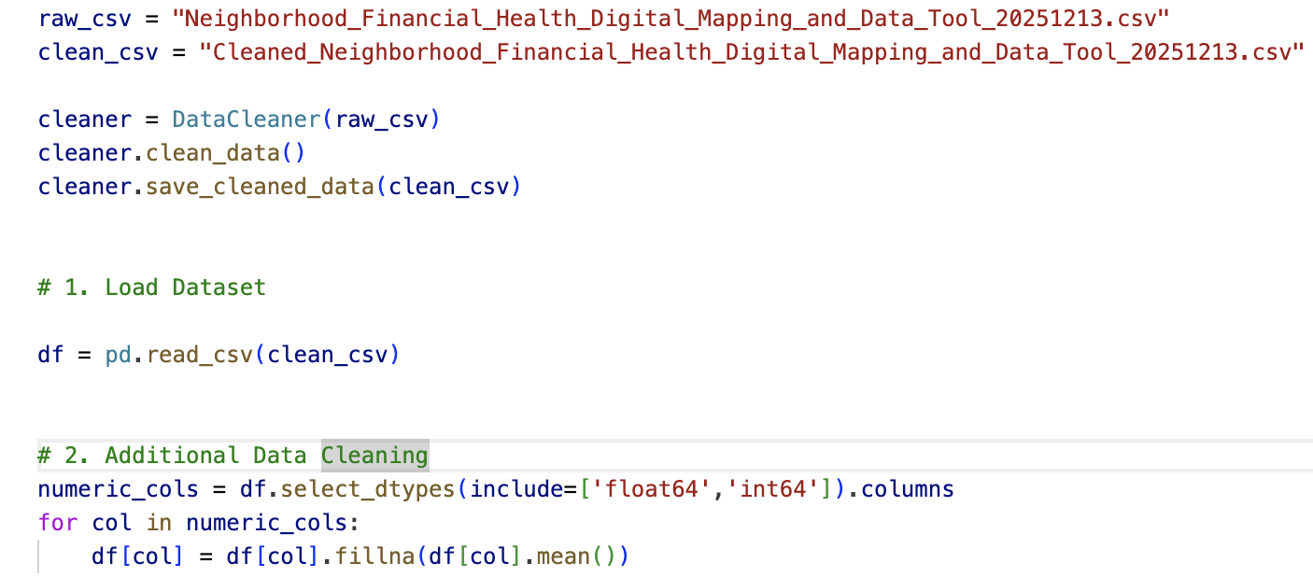
Key Python code segments
Loading the Dataset :

Slide 7
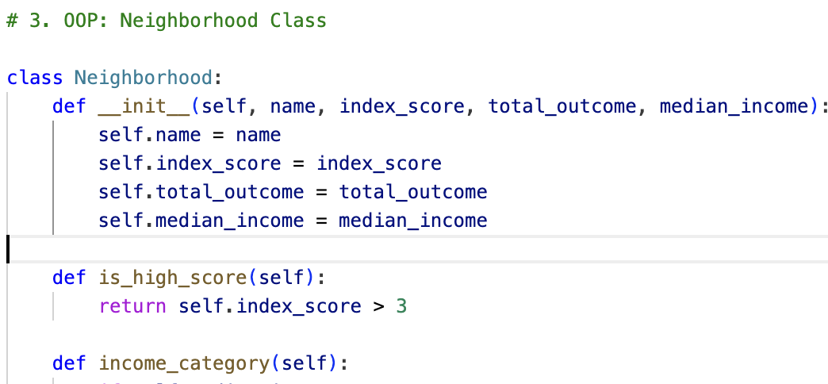
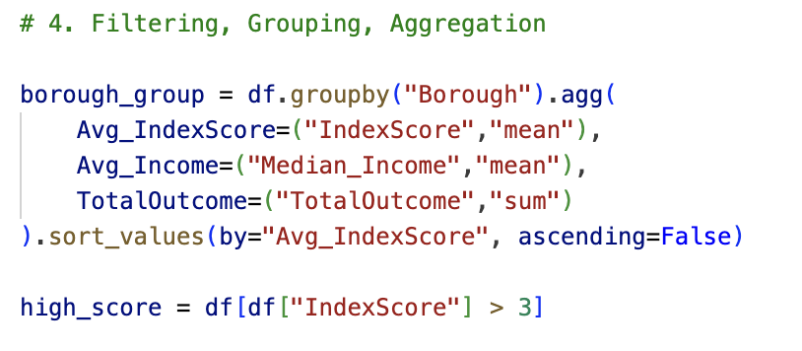
Key Python code segments

Slide 8
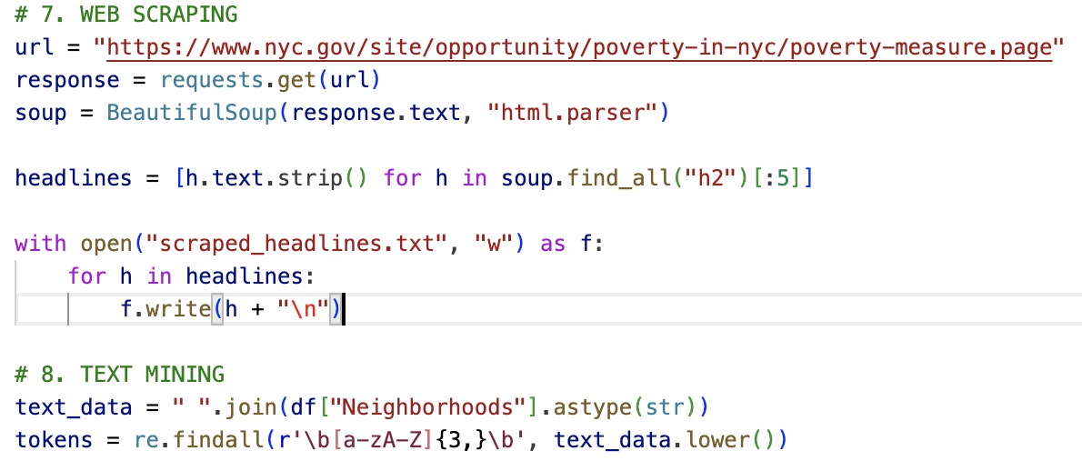
Key Python code segments

Slide 9
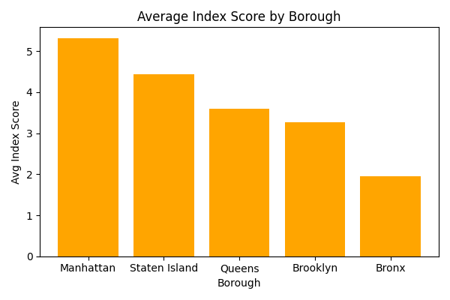
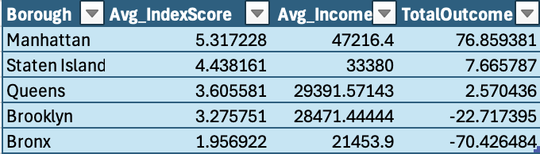
Visualizations
(Bar chart )
Analysis and Findings

Slide 10
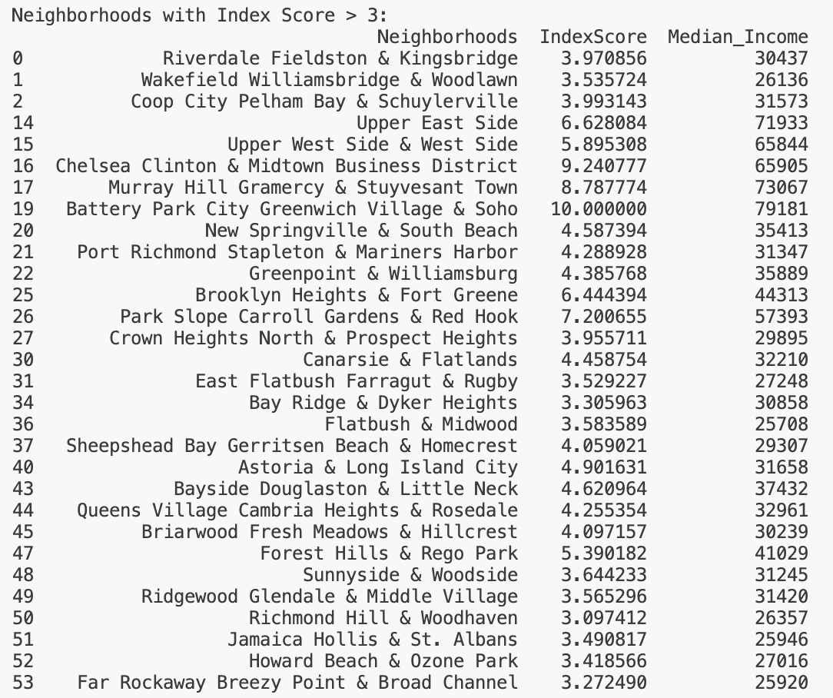
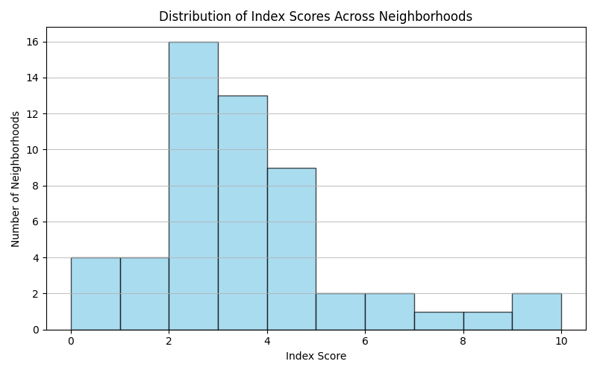
Visualizations(Histogram )
Analysis and Findings

Slide 11
Business & Practical Implications
Policymakers can target low-scoring areas (Bronx)
Businesses can identify investment opportunities
Community organizations can prioritize outreach

Slide 12
Limitations
Sample size
Other external factors

Slide 13
Conclusion & Next Steps
Significant financial health disparities across NYC boroughs
High-income areas perform better financially
Next Steps:
Use multi-year datasets
Add external variables

Slide 14

Thank you

Slide 15
References
Consumer. “Neighborhood Financial Health Digital Mapping and Data Tool.” Cityofnewyork.us, 2 May 2022, data.cityofnewyork.us/Business/Neighborhood-Financial-Health-Digital-Mapping-and-/r3dx-pew9/about_data. https://data.cityofnewyork.us/Business/Neighborhood-Financial-Health-Digital-Mapping-and-/r3dx-pew9/about_data
Visual Studio Code. https://code.visualstudio.com/

